Slide 1

EDA on Titanic Dataset

Slide 2
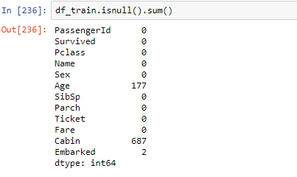
Handled empty values

Slide 3
Handled missing values for age with median values
df_train.loc[(df_train.Survived==1) & (df_train.Sex=='male') & (df_train.Age.isnull()),'Age']=df_train[(df_train.Survived==1) & (df_train.Sex=='male') & (df_train.Age.isnull())]['Age'].apply(set_age_values)
df_train.loc[(df_train.Survived==0) & (df_train.Sex=='male') & (df_train.Age.isnull()),'Age']=df_train[(df_train.Survived==0) & (df_train.Sex=='male') & (df_train.Age.isnull())]['Age'].apply(set_mage_values0)

Slide 4
Handled missing values in other columns by using mode or dropping them
df_train.Embarked = df_train.Embarked.fillna(df_train['Embarked'].mode()[0])
df_train.drop('Cabin',axis=1, inplace=True)

Slide 5
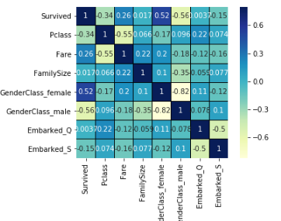
Correlation in Dataset for target

Slide 6
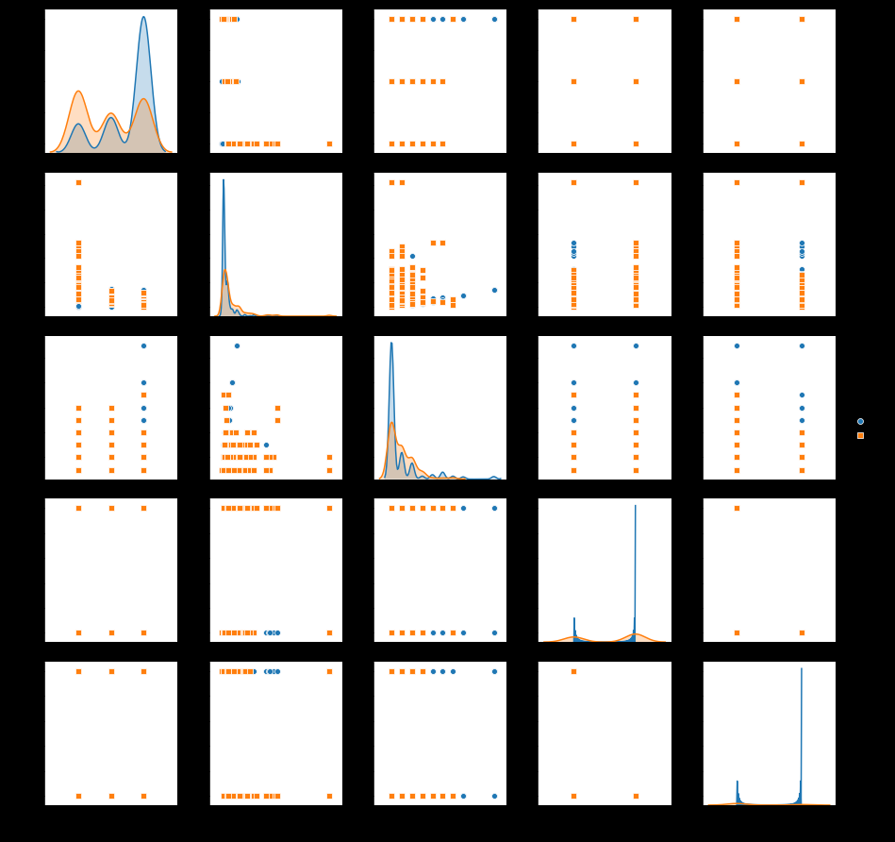
Correlation in input features

Slide 7
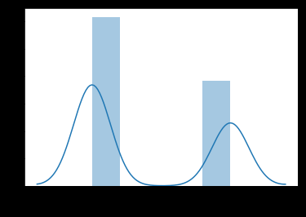
Distribution of Target Variable

